Slide 1

Calendar Program
Final presentation by walid harkous

Slide 2
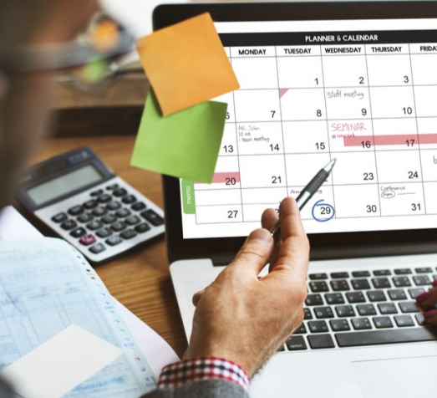
Why pick this project
Straightforward and simple to implement
Not a lot of calendar programs out there with variety
Can add more features in the future
Always wanted to build a schedule builder/ organizer

Slide 3
Brainstorm
Breaking down the program
Designing the UI/interface
Working with variables and different classes
Figuring out how to display different months

Slide 4
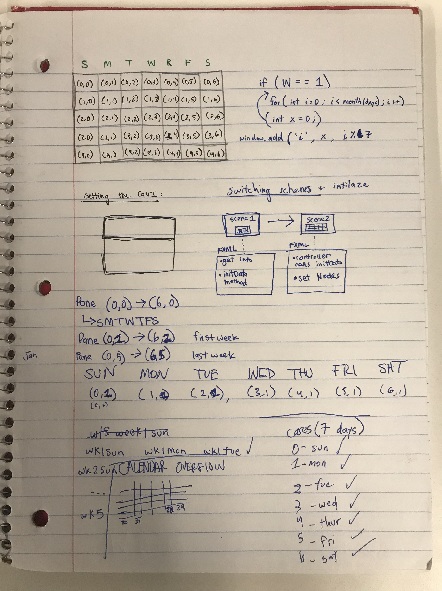
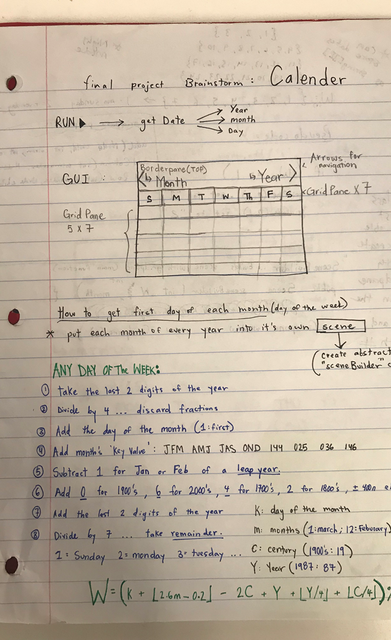

Slide 5
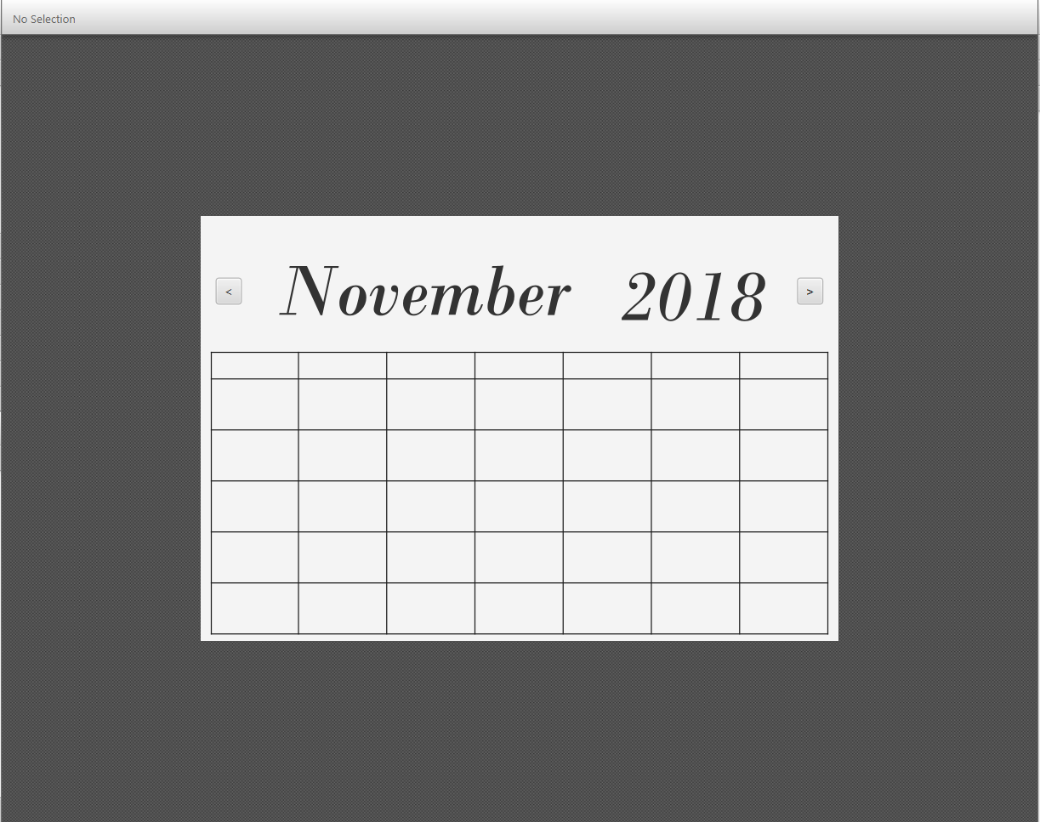
The user interface
Simple and clean
Navigation
Enough space to display each date with any info/event
Resizable

Slide 6
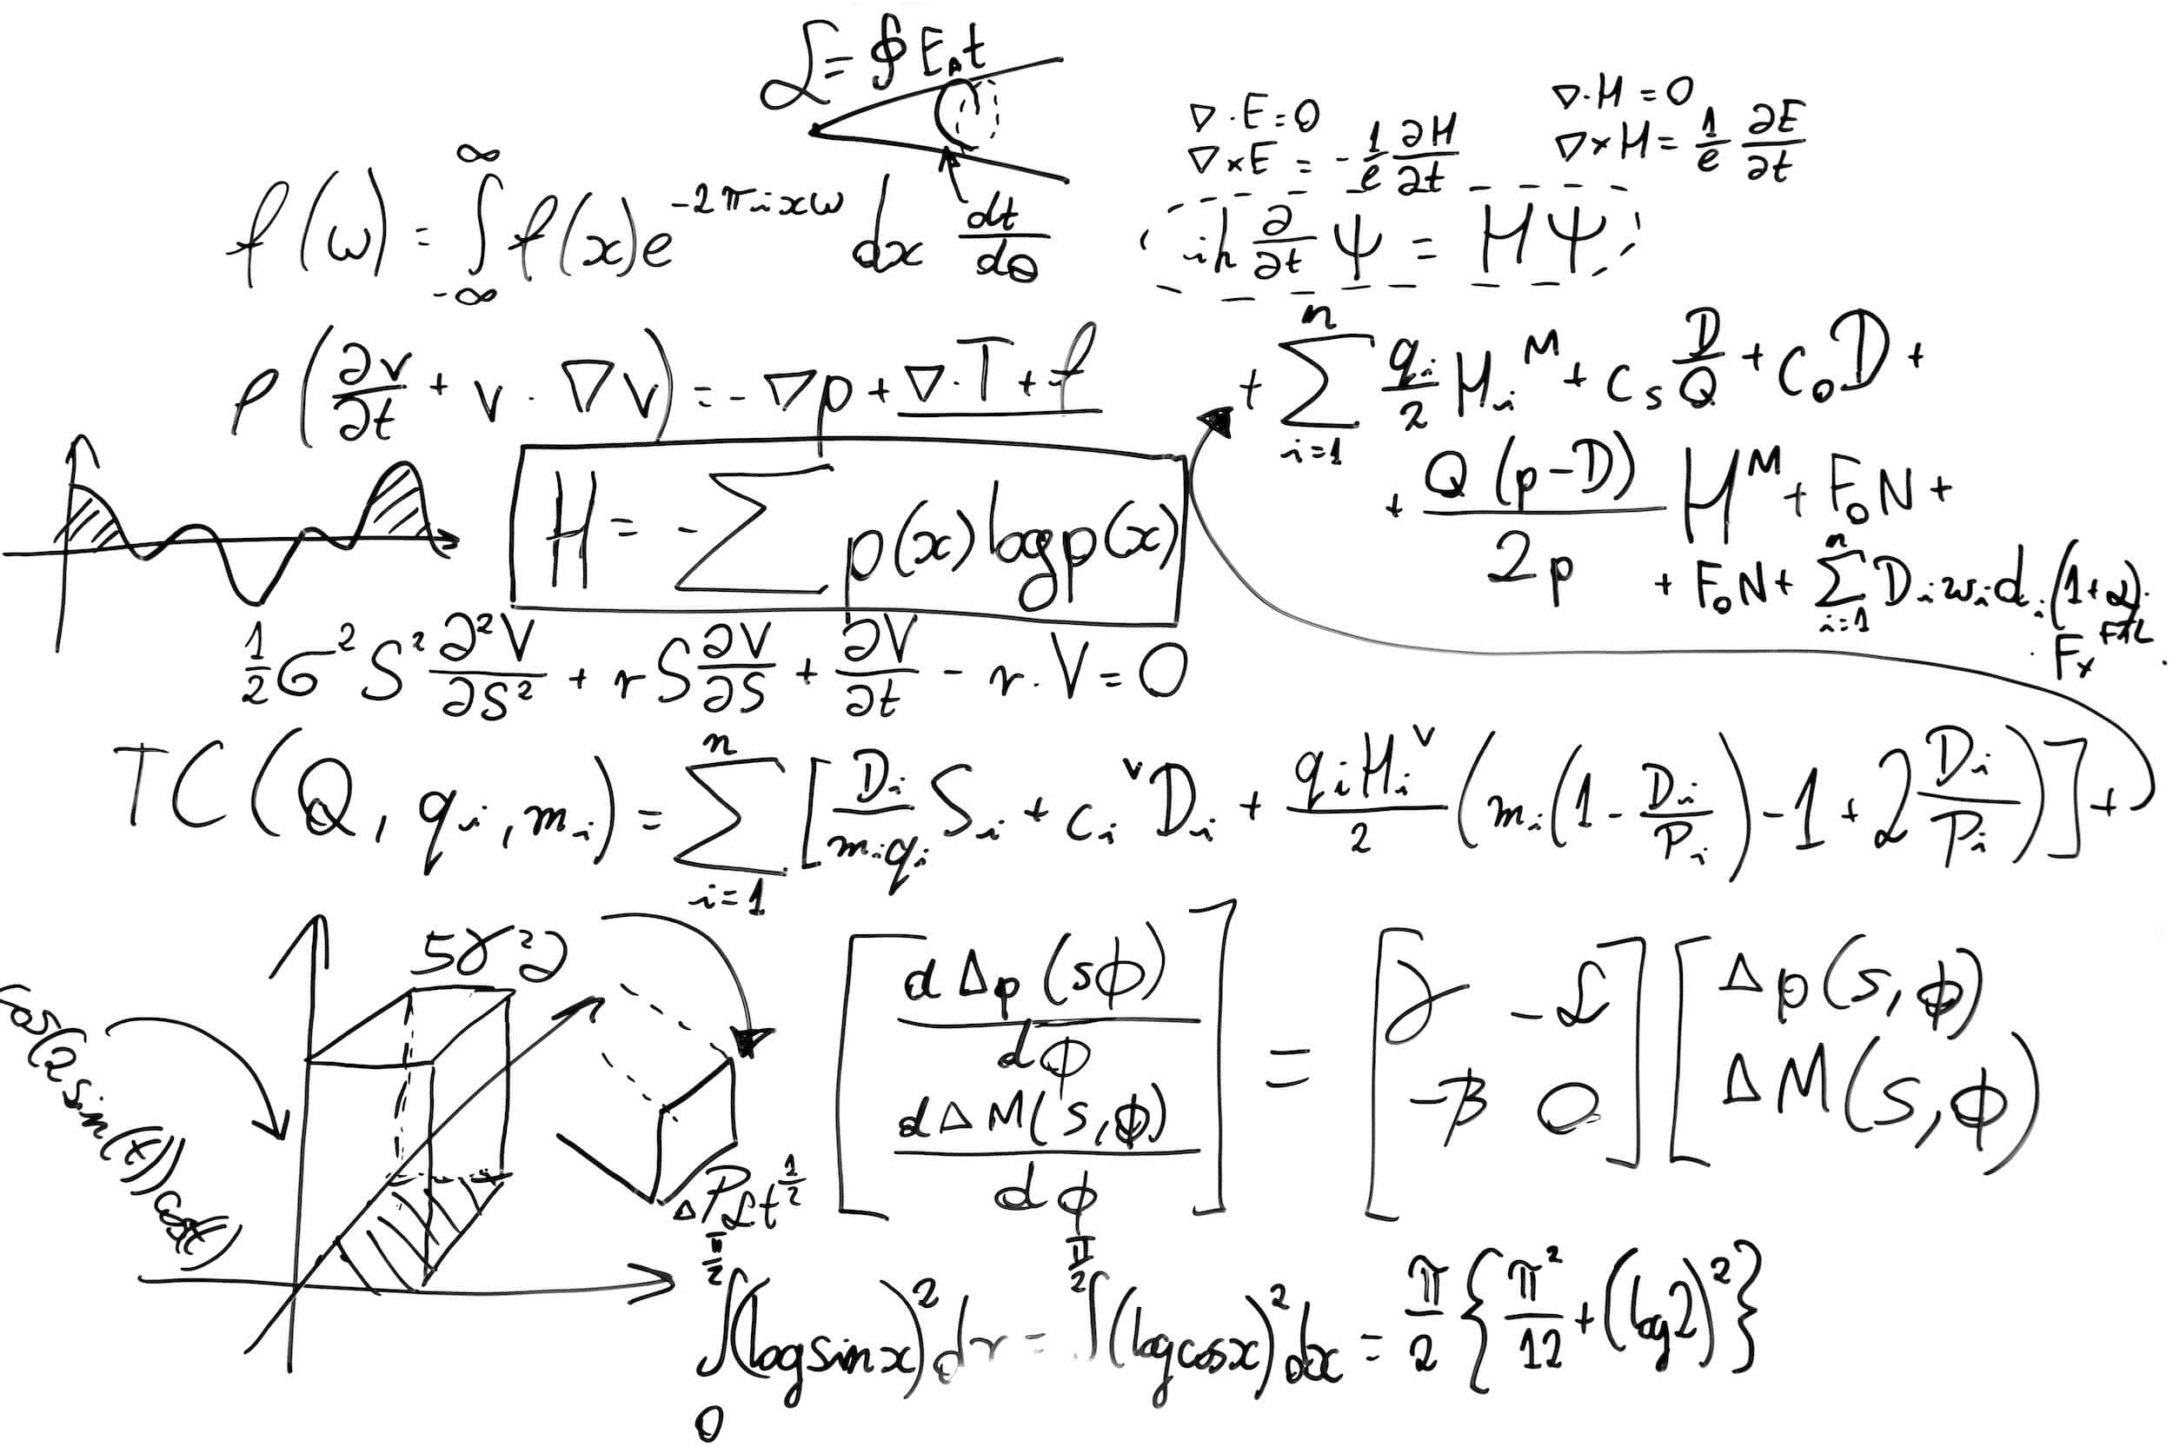
Algorithms
Needed algorithms to figure out:
What day of the week the first of each month lands on
Which years are leap years

Slide 7
Tools and libraries used
JavaFX
Scene Builder
Date and Time Library

Slide 8
A quick demo!

Slide 9
Thank you! Questions?

